Slide 1


equip
#1 The Church
Notes:
Equip - #1 The Church
© 2022 J & A Coughran, The Gospel Seed.

Slide 2
equip
Ephesians 4:11-16 And he gave the apostles, the prophets, the evangelists, the shepherds and teachers, to equip the saints for the work of ministry, for building up the body of Christ, until we all attain to the unity of the faith and of the knowledge of the Son of God, to mature manhood, to the measure of the stature of the fullness of Christ, so that we may no longer be children, tossed to and fro by the waves and carried about by every wind of doctrine, by human cunning, by craftiness in deceitful schemes. Rather, speaking the truth in love, we are to grow up in every way into him who is the head, into Christ, from whom the whole body, joined and held together
by every joint with which it is equipped, when each part is working properly, makes the body grow so that it builds itself up in love.
Notes:
Why ‘Equip’?
Ephesians 4 ¹¹ And he gave the apostles, the prophets, the evangelists, the shepherds and teachers, ¹² to equip the saints for the work of ministry, for building up the body of Christ, ¹³ until we all attain to the unity of the faith and of the knowledge of the Son of God, to mature manhood, to the measure of the stature of the fullness of Christ, ¹⁴ so that we may no longer be children, tossed to and fro by the waves and carried about by every wind of doctrine, by human cunning, by craftiness in deceitful schemes. ¹⁵ Rather, speaking the truth in love, we are to grow up in every way into him who is the head, into Christ, ¹⁶ from whom the whole body, joined and held together by every joint with which it is equipped, when each part is working properly, makes the body grow so that it builds itself up in love.
Because the church is to grow… and God tasks the church with equipping His people for working, ministering, and building each other up, for that growth.
And we do that organically all the time, of course, but we also hope that these dedicated ‘equip’ days will add to our efforts on that front.
Open the Equip Day in prayer – ask God for a productive time, and patience, respect and cooperation as we think through things together and strive towards this unity of the faith that you have called us to.
[This introduction, covered in slides 1-6, should take ~15 minutes]

Slide 3
The ‘what?’ of Church
Church. (n).
church.[1] – “All of God’s people.” e.g. 1 Corinthians 10:32
church.[2] – “A local congregation of [1].” e.g. 1 Corinthians 11:16
church.[3] – “The gathering together of [2].” e.g. 1 Corinthians 11:18
Notes:
We might kick off by exploring church itself – what exactly is church?
The Bible uses the word ‘church’ in a few different ways, and we can see them in play in places like 1 Corinthians… This letter speaks intensely to our attitude and conduct as the church of Jesus, so the word ‘church’ is prominent in this letter, and all 3 senses of the word’s meaning are on display for us pretty clearly, in one place. Here’s a few definitions we might use – [have people flick to these verses so they can self-scan them while these points are being explained]
church.[1] – “All of God’s people.” see 1 Cor 10:32 – the OT way of viewing the world = Jew/Gentile… the NT way of viewing the world = [Jew] → Church ← [Gentile]
church.[2] – “A local congregation of [1].” see 1 Cor 11:16, and cf 1:2 – to the congregation(s) of churches in Corinth (1:2), To finish off a long instruction about the order of gender, Paul argues his case in 11:2-16 on the basis of what all congregations do.
church.[3] – “The gathering together of [2].” see 1 Cor 11:18 – and it becomes crucial to understand this definition for the next few chapters of Paul’s letter → the gathering of the church; a “church service”
Which of these 3 definitions matter? Well, all of them! They are all in the Bible, and we need to learn to accept and embrace all 3.
[1] I hope you all know what it takes to be part of church.[1] – Trust in Jesus Christ is all that you need, or can have, to become part of Jesus’ church…
[2] Some people are content with [1], but neglect [2] & [3]. They identify as being in Christ’s global church, but then fail to meet with, share life with, serve, and do all the other things the Bible commands us as a local family of believers. But church.[2] is inescapable if you read the Bible. Most of the letters – that is, most of the books in the NT – are written to one or more congregations; It is natural & Biblical for God’s people to be part of a local congregation. And that’s what we do here, by committing to each other in this church.[2].
[3] church.[3] is also important. The local congregation gathers… For various reasons that we will think about in a moment, God’s people come together in a dedicated way. And that’s what we do too, as a local church, when we gather together in the sense of church.[3].

Slide 4
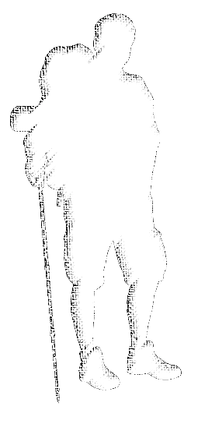
The ‘why?’ of Church.[1]
Ephesians 1:7-10 – as part of God’s plan to unite all things (everywhere) under Christ
Ephesians 3:10 – to proclaim the manifold wisdom of God (everywhere)
Ephesians 3:20-21 – to give glory to God (forever)
Notes:
Why is there a church.[1]?
Well, there’s lots of places we could look to think about that, because the story of the Bible is the story of God pursuing a people to save for Himself. If you think about that, it’s really the story of God bringing about His Church. But let’s think about the following few angles on church.[1], all in the one place of Ephesians… [have 3 people look up these verses and read them out, summarise as per slide]
Ephesians 1:7-10 In him we have redemption through his blood, the forgiveness of our trespasses, according to the riches of his grace, which he lavished upon us, in all wisdom and insight making known to us the mystery of his will, according to his purpose, which he set forth in Christ as a plan for the fullness of time, to unite all things in him, things in heaven and things on earth.
Ephesians 3:10 so that through the church the manifold wisdom of God might now be made known to the rulers and authorities in the heavenly places.
Ephesians 3:20-21 Now to him who is able to do far more abundantly than all that we ask or think, according to the power at work within us, to him be glory in the church and in Christ Jesus throughout all generations, forever and ever. Amen.
There’s loads more reasons, and we’ll see some more in the rest of the sessions today. But in a nutshell, church.[1] exists because God is saving for Himself a people: A people who will be His people, and who will have Him as their God; A people who will bring Him glory.

Slide 5

The ‘what for?’ of Church.[2&3]
Hebrews 10:24-25 – to meet, encourage and stir each other up to love and good works
Hebrews 12:28 – to give worship to God from our hearts of thanks
Hebrews 13:15 – to praise God and proclaim His name
Notes:
Why do we do church.[2&3]? Isn’t it enough that we are saved into relationship with God?
Well, to put it simply, the Bible tells the story of God saving a people, plural. Our modern, highly individualised culture has lost sight of this, and Christians today tend to dwell too much on their own private faith. But the Scriptures are by and large written to a plural, relational culture, of God’s people together. Again, we could draw this truth from all over the Bible, but how about these three reasons to form into local congregations and meet together like so, this time from the letter Hebrews… [have 3 different people look up these verses and read them out, summarise as per slide]
Hebrews 10:24-25 And let us consider how to stir up one another to love and good works, not neglecting to meet together, as is the habit of some, but encouraging one another, and all the more as you see the Day drawing near. (edification, fellowship, encouragement)
Hebrews 12:28 Therefore let us be grateful for receiving a kingdom that cannot be shaken, and thus let us offer to God acceptable worship, with reverence and awe… (thanksgiving, worship)
Hebrews 13:15 Through him then let us continually offer up a sacrifice of praise to God, that is, the fruit of lips that acknowledge his name. (praise, proclamation)
There’s about 6 good reasons for church.[2] and [3] woven into those few verses – to stir each other up to love and good works, to enjoy fellowship, to encourage one another, to give thanks to God, to worship and praise God, and to proclaim God’s name. Basically, church.[2&3] is about building up each other in our faith, working together in community to achieve good works and be a good witness for God, and giving Him our heartfelt thanks and praise.

Slide 6
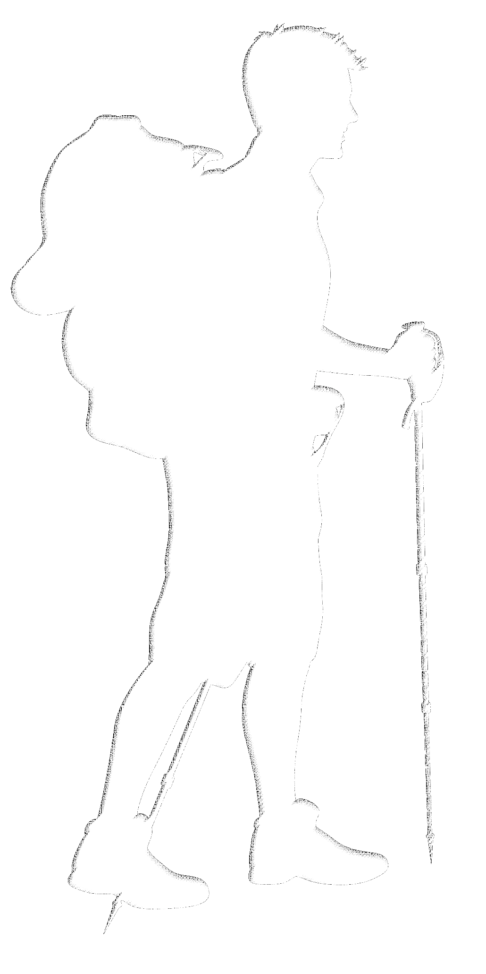
Today’s Teaching Plan
Session 1 – The Church as Jesus’ Mouthpiece
Why do churches drift from their vision? How can we stay on course?
...Morning Tea
Session 2 – The Church as Jesus’ Flock
How we structure our church to best care for His people. Safe ministry in church.
...Lunch
Session 3 – The Church as Jesus’ Family
Committing to one another in love, and dealing with church hurt.
...Afternoon Tea
Notes:
Equip #1 - Overview
Hopefully that brief introduction gets you thinking afresh about church as we now come to today’s 3 sessions.
These should run for about an hour or hour-and-a-half, and we’ll take a meal break in between. In those three sessions, we want to think about our role and function, our care for one another, and our harmony in church.
In session 1, we’ll think about the church’s vision statement, and the importance of staying true to that vision. We’ll get deeper into more Scriptures like the ones we just looked at, and reflect on whether we are tracking faithfully as a church.
In session 2, we’ll explore a few Scriptures that capture the pastoral aspect of church. We’ll have the time to talk through the way church is structured – with provision for elders and so forth – and we’ll run through some safe ministry training, with a little video and a link for you to take home.
In session 3, we’ll think about the vulnerable side of church – learning how to trust and invest in relationships with our brothers and sisters. We’ll do a braindump activity to see if we can chart out an agreement for how we will handle times of church conflict or church hurt, in a Biblical way.
Any burning questions right off the bat?
Ok, let’s get started!

Slide 7
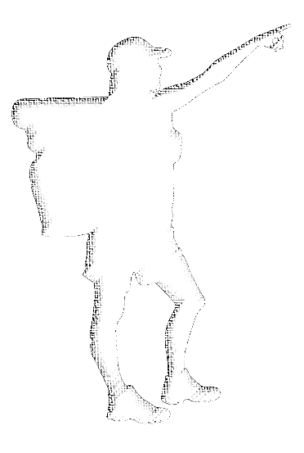
The Church as Jesus’ Mouthpiece
Ephesians 3:10
1 Peter 2:9
Notes:
Session 1 – The Church as Jesus’ Mouthpiece
Hopefully that brief introduction got you thinking afresh about church, and it should set us up nicely for this first session… The Church as Jesus’ Mouthpiece. One of the verses we looked at earlier was Ephesians 3:10, and we might think about that again as we start this session –
Ephesians 3:10 so that through the church the manifold wisdom of God might now be made known to the rulers and authorities in the heavenly places.
This verse gives us a pretty big purpose statement for the church in God’s plans. Another similar call is made in 1 Peter 2:9 –
1 Peter 2:9 But you are a chosen race, a royal priesthood, a holy nation, a people for his own possession, that you may proclaim the excellencies of him who called you out of darkness into his marvelous light.
Clearly, the church has a fundamental role as Jesus’ mouthpiece – to proclaim God and His wisdom to the whole creation. In this session, we’d like to give some thought to how well we are fulfilling this purpose.
[This session, covered in slides 7-9, should take ~75 minutes]

Slide 8
The Church as Jesus’ Mouthpiece
Ephesians 3:10
1 Peter 2:9
This church’s vision...
“Him we proclaim, warning everyone and teaching everyone with all wisdom, that we may present everyone mature in Christ.”
(Colossians 1:28)
Notes:
Vision [Insert the relevant church vision statement in the slide; If there is no vision statement, that itself could be the point of conversation]
The big question we want to frame the session around, is whether this church’s vision captures any part of that role God has called His church to fulfil. Let’s have a look at the vision statement of our humble church here –
“Him we proclaim, warning everyone and teaching everyone with all wisdom, that we may present everyone mature in Christ.” (Colossians 1:28)
Q. How well does this vision statement capture the need to proclaim God and His wisdom?
Q. How could it better reflect that purpose?
In our case, the vision statement is taken from Scripture, and as it happens that Scripture captures the very same sentiment of the 2 verses we already looked at, and the very sentiment therefore of this first session – that we as a local church would function as Jesus’ mouthpiece in our part of the world.
The question, therefore, really becomes one of, ‘How well are we carrying out our vision as a church?” And we might think through that with a short activity… [next slide]

Slide 9
The Church as Jesus’ Mouthpiece
Activity…
Split into 2 teams –
Team 1 – Analyse the elements of our Sunday Service (use last week’s bulletin as a guide)
Team 2 – Analyse various other church ministries (e.g. small groups, young adults, 1-2-1, pastoral ministry)
Discuss:
What role do these elements play in proclaiming Christ?
In what ways might a church lose their focus on proclaiming Christ in these elements?
How can we better proclaim Christ in these things?
Notes:
Taking our Gospel Pulse – Activity
Divide the room into 2 halves (and into small groups within each half if necessary) and set beside each half one of two activities: Have half of the room think through the various elements in the Sunday liturgy (e.g. use the weekly church bulletin as a guide to remind them of those elements, and let them work through that), and have the other half of the room think through the various other ministries the church carries on through the week outside of the Sunday service. Both halves should think through the same 3 questions for their aspect –
What role do these elements play in proclaiming Christ?
In what ways might a church lose their focus on proclaiming Christ in these elements?
How can we better proclaim Christ in these things?
Allow the groups to spend 20-30 minutes discussing this, but give them some butcher’s paper and pens or at least let them know that we will ask them to report back to the whole class on their summary.
Allow 10 minutes each for the summaries from the 2 halves. Facilitator to lead/question/bring out those summaries, and can write key points on the whiteboard.
Spend 5 minutes with the facilitator distilling out or helping the group to distil out some take-home truths.
Close this session in prayer asking Jesus to embolden us, and to refine us, and to give us wisdom to apply difficult things to be better at and more faithful with and focused on proclaiming Him in all that we do as a church.

Slide 10
Morning Tea
Notes:
Break for morning tea – 30 minutes.

Slide 11

The Church as Jesus’ Flock
John 10:14-16
Luke 12:32
Acts 20:28-29
Hebrews 13:17
1 Peter 5:1-9
Notes:
Session 2 – The Church as Jesus’ Flock
To open this session, choose 5 people to open and read these Scriptures. Facilitate by walking through the logic in between…
John 10:14-16 I am the good shepherd. I know my own and my own know me, just as the Father knows me and I know the Father; and I lay down my life for the sheep. And I have other sheep that are not of this fold. I must bring them also, and they will listen to my voice. So there will be one flock, one shepherd.
Jesus has a flock – and the flock is those who listen to Jesus’ voice, and to whom the Father has granted the kingdom –
Luke 12:32 “Fear not, little flock, for it is your Father's good pleasure to give you the kingdom.
And the Holy Spirit puts elders/pastors/shepherds over Jesus’ flock in each church. Let’s look at this text in Acts where Paul is speaking to the elders of the church in Ephesus –
Acts 20:28-30 Pay careful attention to yourselves and to all the flock, in which the Holy Spirit has made you overseers, to care for the church of God, which he obtained with his own blood. I know that after my departure fierce wolves will come in among you, not sparing the flock; and from among your own selves will arise men speaking twisted things, to draw away the disciples after them.
Hebrews 13:17 Obey your leaders and submit to them, for they are keeping watch over your souls, as those who will have to give an account. Let them do this with joy and not with groaning, for that would be of no advantage to you.
1 Peter 5:1-9 So I exhort the elders among you, as a fellow elder and a witness of the sufferings of Christ, as well as a partaker in the glory that is going to be revealed: shepherd the flock of God that is among you, exercising oversight, not under compulsion, but willingly, as God would have you; not for shameful gain, but eagerly; not domineering over those in your charge, but being examples to the flock. And when the chief Shepherd appears, you will receive the unfading crown of glory. Likewise, you who are younger, be subject to the elders. Clothe yourselves, all of you, with humility toward one another, for “God opposes the proud but gives grace to the humble.” Humble yourselves, therefore, under the mighty hand of God so that at the proper time he may exalt you, casting all your anxieties on him, because he cares for you. Be sober-minded; be watchful. Your adversary the devil prowls around like a roaring lion, seeking someone to devour. Resist him, firm in your faith, knowing that the same kinds of suffering are being experienced by your brotherhood throughout the world.
Notice how Peter writes of this role in various synonyms, ‘shepherd’, ‘elder’, ‘overseer’ (which today, some churches call ‘bishops’). In Peter’s mind, the three terms describe one and the same role. And all these and other Scriptures explain why we have elders/pastors/shepherds in a local church. Jesus appoints elders to watch over and care for the flock by the power of the Holy Spirit. They are to lead willingly, eagerly and with godly example, as those who have been entrusted with the care and wellbeing of the souls of those under their care. They will give an answer to the way they carried out that ministry from God. The flock, meanwhile, are called to submit and listen to those shepherds, for their own well-being. Peter is also clear to remind us that we all have an obligation of humility towards each other – so all of Jesus’ sheep are involved in a ministry of care and respect for one another.
[Allow 10 minutes – questions/reflections/thoughts on pastoral structure of church]
[This session, covered in slides 11-12, should take ~60-90 minutes]

Slide 12
The Church as Jesus’ Flock
Safe Ministry
  Policy –
  Code of Conduct –
  Safe Ministry Process –
  Safe Ministry Contacts –
Safe Ministry Check
  Screening
  Training (all church, volunteers and ministry leaders, board members and elders)
Notes:
Safe Ministry – Training
[Insert the relevant details and links for your church documents, and the details of the safe ministry contacts; If using something other than Safe Ministry Check, replace details.]
In addition to the pastoral structure of elders watching over the care of the flock, we also have formal obligations to promote a safe environment and manage shortcomings in that. In the rest of this session, we want to focus particularly on our approach to “Safe Ministry” – particularly in the area of child or vulnerable person abuse – and our policy documents that guide us in that as a church.
Explain the components of Safe Ministry internally – the church Safe Ministry Policy, Code of Conduct, Process, and Contacts if you have concerns.
As children of God we should all capture the seriousness and the sensitivity of this area, and how we are committed to cultivating a church environment where people speak up about concerns, but with a framework that allows us to watch Biblically and carefully over our people in all positions. We believe the church has the foremost role in pastoral care, and this extends to safe ministry in the area of abuse protection. So too, as a church of God we want everyone in our community here to be above reproach (Colossians 1:22, 1 Timothy 3:2), and so we exercise our care in this area first and foremost because we are a community of our Lord Jesus Christ.
Discuss too our legal commitments and obligations, and our choice to use Safe Ministry Check to help us screen leaders and train all people in the church about safe ministry, so that this is out in the open and known by the members of our church. Explain the different levels of training available, starting with the Awareness Course that we want all of our members to complete.
If possible on the day, have a leader log in and complete the Safe Ministry Awareness Course as a group exercise (requires 25-30 min). The people who take part can later be marked as having completed it. Offer also to email invites directly to those who would like to complete it in their own time.
Close this session in prayer asking Jesus to watch over us, and to help us to watch over each other in a Biblical way that glorifies Him in all that we do as a church.
[This session, covered in slides 10-12, should take ~60-90 minutes]

Slide 13
Lunch
Notes:
Break for Lunch

Slide 14
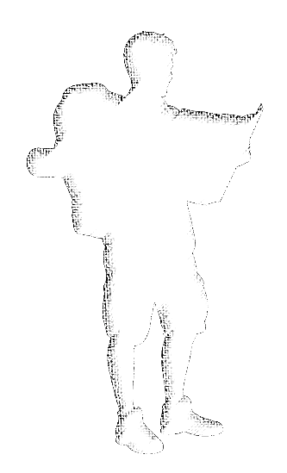
The Church as Jesus’ Family
Matthew 12:49-50
John 1:12-13
John 19:26-27
Ephesians 2:19-22
Hebrews 2:10-18
Notes:
Session 3 – The Church as Jesus’ Family
To open this session, choose 5 people to open and read these Scriptures. Facilitate by walking through the logic in between…
Matthew 12:49-50 And stretching out his hand toward his disciples, he said, “Here are my mother and my brothers! For whoever does the will of my Father in heaven is my brother and sister and mother.”
Jesus considers that all those who do the will of the Father is his family. So too, in John’s gospel we learn that those people who obey the Father are also people who receive Jesus –
John 1:12-13 But to all who did receive him, who believed in his name, he gave the right to become children of God, who were born, not of blood nor of the will of the flesh nor of the will of man, but of God.
Jesus spoke of this concept very personally, even of his own literal family and friends, in a way that they quite literally received –
John 19:26-27 When Jesus saw his mother and the disciple whom he loved standing nearby, he said to his mother, “Woman, behold, your son!” Then he said to the disciple, “Behold, your mother!” And from that hour the disciple took her to his own home.
The New Testament letters continue to speak of Christians as Jesus’ family, in places such as Ephesians 2 –
Ephesians 2:19-22 So then you are no longer strangers and aliens, but you are fellow citizens with the saints and members of the household of God, built on the foundation of the apostles and prophets, Christ Jesus himself being the cornerstone, in whom the whole structure, being joined together, grows into a holy temple in the Lord. In him you also are being built together into a dwelling place for God by the Spirit.
And we might reflect too, on just how much Jesus gave for us to become his family –
Hebrews 2:10-18 For it was fitting that he, for whom and by whom all things exist, in bringing many sons to glory, should make the founder of their salvation perfect through suffering. For he who sanctifies and those who are sanctified all have one source. That is why he is not ashamed to call them brothers, saying, “I will tell of your name to my brothers; in the midst of the congregation I will sing your praise.” And again, “I will put my trust in him.” And again, “Behold, I and the children God has given me.” Since therefore the children share in flesh and blood, he himself likewise partook of the same things, that through death he might destroy the one who has the power of death, that is, the devil, and deliver all those who through fear of death were subject to lifelong slavery. For surely it is not angels that he helps, but he helps the offspring of Abraham. Therefore he had to be made like his brothers in every respect, so that he might become a merciful and faithful high priest in the service of God, to make propitiation for the sins of the people. For because he himself has suffered when tempted, he is able to help those who are being tempted.
[Allow 10 minutes – questions/reflections/thoughts on church as a family of God]
[This session, covered in slides 14-15, should take ~60-90 minutes]

Slide 15
The Church as Jesus’ Family
Activity…
Church conflict & church hurt
Notes:
Conflict & Hurt – Activity
It’s often in family that we come up against the most difficult conflict, and the most lasting hurt. So too, we might expect conflict and hurt to be a part of our life in church, given that we are Jesus’ family. We don’t get to choose that family, and yet we must walk in love with the brothers and sisters whom God puts in front of us… and that is necessarily going to require us to know how to map our way through conflict and hurt together. Too easily, Christians simply walk out of their church family when conflict or hurt comes – or they push the other party out. But this is not acceptable, and nor should we think it would be pleasing to God. Far better for us to be honest about the reality of hurt and conflict – it is bound to happen, so we should prepare for it, acknowledge it when it comes, and step into it together in a godly way to pursue peace and unity in the family of God.
In the rest of this session, we want to start a process around how we will navigate church conflict and church hurt. We won’t finish that process, but we will start, and carry on in later sessions together. And we want to do this, from the ground up – having you, as the people of Jesus’ family, think through together, how we can model Christ in the midst of conflict or hurt in his family. So we want to think through this area as a church, and begin a process today that helps our whole church family craft its’ own strategy or agreement as to how we will walk through times of conflict or hurt.
To do that, today we will start with an activity. Let me give you the gist of the activity first, and then some simple ground-rules to keep us on track…
The Gist – We want everyone to reflect and share about situations they have seen church conflict or church hurt managed well (or poorly). From those experiences, we then want to extract out the PRINCIPLES that make for healthy handling of church conflict and hurt.
The Ground-rules –
[1] Keep it short and to the point. We are going to share our experiences in very brief form, just in terms of the main details. Therefore, we will set a timer to constrain us – there will be 1 minute to share, so please think through the main points about that experience that you want to share and contribute to our thinktank here. We don’t want this to drift into group therapy over our past experiences. Sharing our experiences in very brief form today might well flow into that at another time, but today we want to stay focused on extracting the principles behind healthy management of conflict and hurt in the family of Jesus.
[2] Keep it respectful. Please don’t mention any other church name, or any other church leader, or any other brother or sister. We just want to think through our collective experiences, to get to the principles of managing conflict and hurt well.
Part 1: So keeping it respectful and to the point, spend a few minutes thinking back through your experiences and church hurt, and which things you are willing to share, and then we will see if we can speak into this space in a constructive way. [Allow a few minutes for people to think and prepare; Facilitator to write ‘Church Conflict/Hurt’ across top of whiteboard, and then underneath divide whiteboard in half L/R, writing ‘Experience’ above the LHS. Then, invite people to share, one by one, in a one-minute basic gist summary of where they saw church conflict/hurt done well/poorly. Use the Sand Timer app to lighten the difficulty of the time factor. All listen when each person shares, and after the minute is up the facilitator to extract out key points of what happened (take care not to get into ‘principles’, just write down the facts of the experience) onto the LHS of the whiteboard. Allow for 30 minutes for this session; Remind people there will be other occasions to speak more, this is a first session to get us thinking in this space.]
Part 2: [Facilitator to write ‘Principles’ as the heading of the RHS of the whiteboard, and ask the whole group:] If we try to distil the main gist pulled out of all these experiences, what kind of principles do you think we could construct about how to handle church conflict and church hurt? Whether these were positive or negative experiences at the time, what are the underlying principles at play that we could factor into our own church’s strategy about how to navigate the difficult space of church conflict and hurt? [As the group processes the LHS key points about everyone’s experiences, lead them towards identifying principles at play, and see if the group can word those principles for the facilitator to write in the RHS of the whiteboard. Allow 20 minutes for this part.]
Part 3: Let’s look up a Scripture where the early church had to walk through some conflict… in Acts 6:1-7. [Have everyone open Acts 6, and someone read the passage. Facilitator to then ask the following questions. Allow 15 minutes for this part.]
Exegetical questions:
What was the opening context?
What was the cause of the conflict?
Who developed a strategy to handle the conflict?
Who had responsibility to carry out the plan?
What was the outcome?
Application questions:
Were any of the principles at play in managing this church conflict similar to those we identified? [i.e., in Part 2]
Are there any principles at play that we could draw into our list here?
Part 4: As we wind up this session, let me remind you again that this is just an opening session in this space of church hurt and conflict. We are committed to each other in this church, as brothers and sisters of Jesus’ family, and so we plan to keep exploring how to navigate these inevitable difficulties well. To keep that conversation going beyond today, let’s nominate a couple of people to photograph this whiteboard, and go away over the next month or so and try to capture this in a simple written summary – like half a page or a page that brings together this progress we’ve just made about church hurt and church conflict, and the principles we’ve just identified that we feel are important to carry into those future conversations in this area. Then, next time we pick this topic up, we can all review their summary, and keep crafting a way forward with this. [Have the people nominate a couple of people for this homework task.]
Close this session in prayer for us as Jesus’ family – that he would teach us to walk lovingly with each other and to step through conflict and hurt when it comes in a loyal and Jesus-honoring way.

Slide 16
Prayer
Notes:
Prayer
Spend 10 minutes in open prayer, committing the whole equip teaching day to God.
Facilitator to close prayer, asking that the Spirit of Christ would be active within and among us, such that we forge together as a church worthy of his name. Specifically, ask that God would move us to be focused and bold with our proclamation of God and His promises, to watch over each other pastorally in a Biblical way, and to love one another as the very brothers and sisters of Christ.

Slide 17
Afternoon Tea
Notes:
Retire to Afternoon Tea

