Slide 1
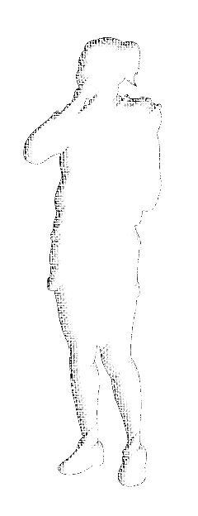

equip
#2 The Gospel
Notes:
Equip - #2 The Gospel
© 2022 J & A Coughran, The Gospel Seed.

Slide 2
equip
Ephesians 4:11-16 And he gave the apostles, the prophets, the evangelists, the shepherds and teachers, to equip the saints for the work of ministry, for building up the body of Christ, until we all attain to the unity of the faith and of the knowledge of the Son of God, to mature manhood, to the measure of the stature of the fullness of Christ, so that we may no longer be children, tossed to and fro by the waves and carried about by every wind of doctrine, by human cunning, by craftiness in deceitful schemes. Rather, speaking the truth in love, we are to grow up in every way into him who is the head, into Christ, from whom the whole body, joined and held together
by every joint with which it is equipped, when each part is working properly, makes the body grow so that it builds itself up in love.
Notes:
Why ‘Equip’?
Ephesians 4 ¹¹ And he gave the apostles, the prophets, the evangelists, the shepherds and teachers, ¹² to equip the saints for the work of ministry, for building up the body of Christ, ¹³ until we all attain to the unity of the faith and of the knowledge of the Son of God, to mature manhood, to the measure of the stature of the fullness of Christ, ¹⁴ so that we may no longer be children, tossed to and fro by the waves and carried about by every wind of doctrine, by human cunning, by craftiness in deceitful schemes. ¹⁵ Rather, speaking the truth in love, we are to grow up in every way into him who is the head, into Christ, ¹⁶ from whom the whole body, joined and held together by every joint with which it is equipped, when each part is working properly, makes the body grow so that it builds itself up in love.
Because the church is to grow… and God tasks the church with equipping His people for working, ministering, and building each other up, for that growth.
And we do that organically all the time, of course, but we also hope that these dedicated ‘equip’ days will add to our efforts on that front.
Open the Equip Day in prayer – ask God for a productive time, and patience, respect and cooperation as we think through things together and strive towards this unity of the faith that you have called us to.
[This introduction and recap, covered in slides 1-6, should take ~15 minutes]

Slide 3
equip
Last time… #1 “The Church”
The church as Jesus’ Mouthpiece
The church as Jesus’ Flock
The church as Jesus’ Family
Notes:
We might recap where we were in our last equip session, when we thought broadly about “the Church”… In that session, we thought of three aspects of church –
1] the church as Jesus’ mouthpiece
2] the church as Jesus’ flock
3] the church as Jesus’ family
Today, we want to dive in and explore more fully, the first of those dimensions to church. In that, given that we have a role to proclaim Jesus’ gospel, we need to think about what that gospel is, and how we might be able to share it.

Slide 4
equip #2 – the Gospel
For I am not ashamed of the gospel,*
for it is the power of God for salvation to everyone who believes,
to the Jew first and also to the Greek.
Romans 1:16
* Gospel. n. God’s good news to humans ¹
Notes:
And so in this equip, that’s where we’ll focus in – on the gospel of Jesus that we must proclaim as a church in his name.
Here’s a challenge from Scripture to kick us off on this topic. The Apostle Paul says in Romans 1:16,
For I am not ashamed of the gospel, for it is the power of God for salvation to everyone who believes, to the Jew first and also to the Greek. (Romans 1:16)
Clearly the gospel is important – it is the power of God to save all who believe in it.
But what exactly is it? In all these pages of Scripture, what things comprise the ‘gospel’ that is God’s power to save people?
And in what way should our church be part of getting God’s gospel to those who need to believe it?
¹ Danker, F.W., Arndt, W.F., Gingrich, F.W. & Bauer, W. (2020). A Greek-English Lexicon of the New Testament and other Early Christian Literature. Third Edition. (BDAG). University of Chicago.

Slide 5
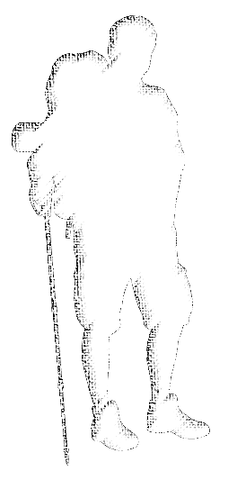
equip #2 – the Gospel
“The Gospel”
What is the gospel?
How can we share the gospel?
Notes:
Those are the 2 questions that we’ll try to take on today, as a church together. In short form,
What is the gospel?
And, How can we share the gospel?

Slide 6
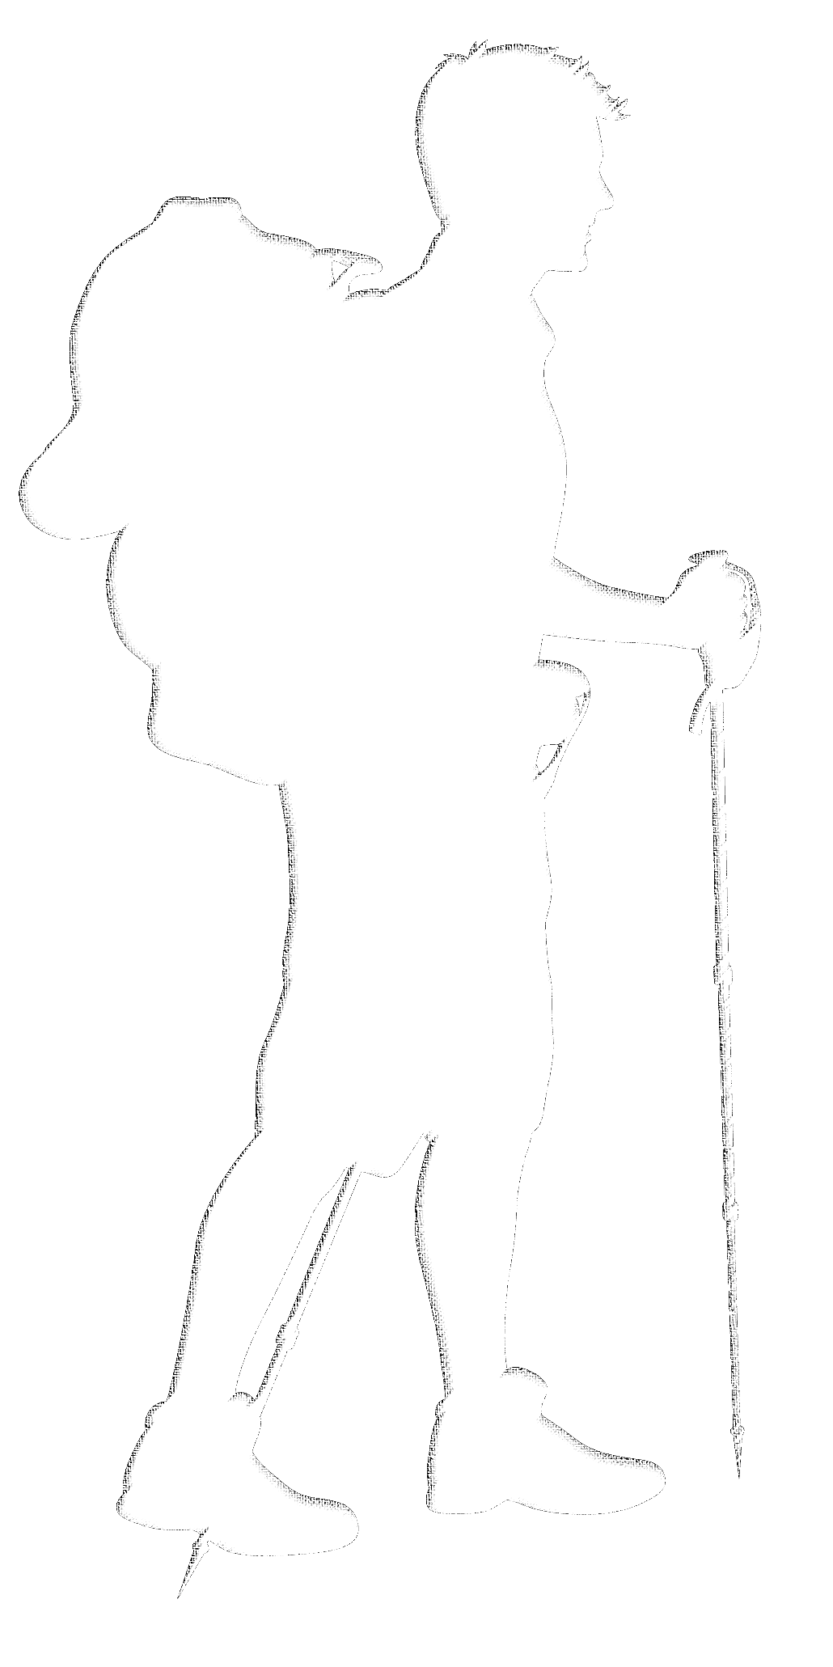
Today’s Teaching Plan
Session 1 – What is the Gospel?
What do we think the Gospel is? And how did Jesus and his Apostles explain the gospel?
... Lunch
Session 2 – How can we share the Gospel?
How can we present the Gospel to others? (personally, collectively, concretely)
Notes:
Equip #2 - Overview
So that’s what we hope to think through today, and we’ll try to do that in 2 sessions – but we’ll have a few different angles on each of those questions.
In session 1, we’ll try to get a clear fix on what the gospel is – what are the key elements, of the gospel, and how do they fit together?
In session 2, we’ll try to think through how we can share the gospel with others – personally, and collectively – and thinking concretely, what will we do, to present Christ in our part of the world?
The 2 sessions should run for a couple of hours or so, and we’ll take a lunch break in between.
Any burning questions right off the bat?
Ok, let’s get started!

Slide 7
What is the Gospel?
Then after 14 years I went up again to Jerusalem with Barnabas, taking Titus along with me.
I went up because of a revelation and set before them
(though privately before those who seemed influential)
the gospel that I proclaim among the Gentiles,
in order to make sure I was not running or had not run in vain.
Galatians 2:1-2
Notes:
Session 1 – What is the Gospel?
To get us into a healthy and humble mindset for this first session, let’s reflect briefly on this Scripture from Galatians.
Then after fourteen years I went up again to Jerusalem with Barnabas, taking Titus along with me. I went up because of a revelation and set before them (though privately before those who seemed influential) the gospel that I proclaim among the Gentiles, in order to make sure I was not running or had not run in vain. Galatians 2:1-2
The Apostle Paul gives an account of his early ministry in Galatians 1, and part of that (here in Galatians 2:1-2) involved sitting before the other elders in Jesus’ church and laying bare what exactly he had been proclaiming to those who didn’t know Jesus. He has the conscientiousness, and the humility we would think, to take time out and make sure that he was not proclaiming some kind of gospel that was missing, or adding, or mis-emphasizing anything that comprise, the gospel.
If Paul was so conscientious, having been commissioned by direct revelation of the gospel from Jesus (as he had described in ch.1), then surely so too should we take time out every once in a while, to make sure we haven’t missed or added or mis-emphasized anything, when we think about the gospel, as the power of God to save sinners.
So perhaps I could ask that we all be humble, and cooperative, and teachable, and conscientious, as we go about this first session.
[This session, covered in slides 7-12, should take 1.5 – 2 hours – so allow about 30-40 minutes for each part]

Slide 8

What is the Gospel?
Activity – Brainstorm
Discovery – Scripture
Consensus?
Notes:
As we therefore come to think about what the gospel is, we’ll break this first session up into a few stages –
First, we’ll have an open brainstorm – we’ll just try to think about this question and see if we can come up with a basic list of what we think the key components of the gospel are.
Then, we’ll look through a few Scriptures to see how Jesus’ Apostles went about explaining the gospel – “what did they think the key components were?” Since we have the Scriptures, and they include some of the accounts of Jesus’ Apostles communicating the gospel to people in sermons and so on, we can essentially do what Paul did in Galatians 2:1-2 – we can cross-reference our thoughts, with how Jesus’ Apostles presented the gospel, and see if there’s anything we might’ve missed, or added, or mistakenly majored or minored on.
And finally, we’ll see if we can put 1 & 2 together, and try to formulate something clear and concise, that we are in basic agreement about in terms of what the gospel is.

Slide 9
What is the Gospel?
Brainstorm…
Scribe: Jot down all the suggestions
Everyone else: “What are the important elements of the gospel?
Scenario – Emily / Liver Failure / Family not sure what most important / 10 minute opportunity
Notes:
1. Activity – Brainstorm
Let’s start by brainstorming what we instinctively think are the important components of the gospel. We might all have different ideas on that, which is okay, because we’re not looking for consensus on the question just yet… so we don’t need to start any debates, we just want to collect together all the different things that people think are the fundamental and essential parts of the gospel message. (It may be necessary to guide people away from their Bibles in this activity – let them know we will come to that later, but first we want to think from our experience and understanding as Christians).
To help us focus, let me frame this brainstorm in terms of this simple scenario: “Without notice, Emily suffered liver failure, and was hospitalised but could not be treated; She was given days or weeks to live. Emily’s family desperately want to tell her the gospel, but they aren’t sure how much time they have – opportunities to visit are few and fleeting when they come, and it seems there won’t be many. In the suddenness of the shock, they aren’t sure what to say. Can you help them? Assuming someone gets a chance to speak with Emily for 10 minutes, what are the key elements of the gospel that you’d suggest they share with her?”
Allow 20 minutes for a brainstorm on what elements would be important to cover the gospel well, with a scribe appointed to jot down all the elements that are brainstormed on paper.

Slide 10
What is the Gospel?
Brainstorm…
Scribe: Jot down all the suggestions
Everyone else: “What are the important elements of the gospel?
Scenario – Emily / Liver Failure / Family not sure what most important / 10 minute opportunity
Synthesis: One suggestion per page
Prioritisation: LHS = little importance / RHS = vital importance
Notes:
1. Activity – Brainstorm (continued)
Now, allowing another 5-10 minutes, have the facilitator to try to capture each element crisply (one word if possible: e.g. “sin”), and write each element on its own piece of paper (i.e., end up with a series of paper sheets, each with one word/element on it). Leave room on the bottom half of the page for some later steps. Everyone can listen to the scribe and provide further refinement on the words/elements as each one is written down on its page.
Then, allow 5 minutes for the facilitator to stick the pages around the walls or the room (e.g. with blu-tak or tape), and draw a “importance scale” across the page under each word (leave enough room to draw another scale below it, later). The left hand side can mean ‘little importance’ and the right hand side ‘vital importance’.
Finally, invite everyone to take a pen and draw a star on the scale, where they think it would reflect how important they think it is to include that element in the overall message of the gospel. (use identical dot stickers if need be to avoid people comparing/identifying others’ marks). Tell people not to be worried about what other people mark, and make sure the marks are indistinct… that’s not the point of these marks; We just want to capture the range of thought. Allow 5 minutes for this, and ask everyone to make sure to mark every element (even if they don’t think it is important, they should mark that on the left hand side of the scale).

Slide 11
What is the Gospel?
Discovery…
What did Jesus’ Apostles emphasize?
In pairs: Read, discuss, highlight the key elements (and anything about the context etc that catches your eye)
Notes:
2. Discovery – Scripture
Divide people into pairs, and assign each pair one of the following Scriptures. Have the Scriptures pre-printed on paper so that the pair can read from the same page, and give them highlighters and pens. Ask each pair to read and talk together about their passage for 10 minutes, highlighting what the key elements in that gospel presentation include.
Example Scriptures – and see attached word document for pages to pre-print – Acts 2:14-41, Acts 3:11-26, Acts 8:4-13, Acts 10:30-43 (cf Acts 15:7), Acts 17:22-31, Acts 26:1-29, 1 Corinthians 1:20-25 and 15:1-11
Some additional ideas – John the Baptist and Jesus – Mark 1:1-15 and Luke 24:44-49, or the Angels – Luke 24:1-7 and Revelation 14:6-13
Possible option – Acts 7:1-53
People can use their own Scriptures if they have another favourite account of (or description of) preaching the good news in Scripture.
After the 10 minutes, have each pair report to the whole group on: (i) what their passage was; (ii) who was presenting the gospel in it; (iii) what the key elements were in their presentation of the gospel; and (iv) if anything else struck them about the account. Allow 20-30 minutes for this part, and encourage a little bit of discussion with each report. Have the facilitator visibly/audibly create a running list and tally for the elements as each pair reports back.

Slide 12
What is the Gospel?
Consensus…
List check.
Tally check.
Discussion…
Summary: Distilling a gospel consensus.
Notes:
3. Consensus
Use the list from step 2 (Apostles presenting the gospel in Scripture) to check the pages on the wall from step 1 (our own thoughts on the key elements of the gospel). Add new pages if some new element was found in step 2 that wasn’t thought of in step 1.
Then, use the tally from step 2 to add a new mark – different in colour/style to the people’s marks from part 1 – on the importance scales on the pages around the wall.
Discuss with the group any discrepancies – comparing the people’s list and prioritization of elements from step 1 with the Apostolic gospel messages of this step 2, is there anything in our own thinking that seems to be missing, or added, or perhaps misemphasized (e.g. majoring on minors, minoring on majors)?
If appropriate, and if time permits, probe why we might have had different ideas to the Apostles. Is it about courage, clarity, conviction, or something else?
Allow 30 minutes for this, making sure to examine each page/element of the gospel.
Finally, have the facilitator lead the group into a consensus as to what things are core to the gospel. In other words, putting 1 and 2 together, what does this church community feel is important to convey to those around us who need the power of God’s gospel to save them.

Slide 13
Lunch
Notes:
Break for lunch.

Slide 14
How can we share the Gospel?
How then will they call on him in whom they have not believed?
And how are they to believe in him of whom they have never heard?
And how are they to hear without someone preaching?
And how are they to preach unless they are sent?
As it is written, “How beautiful are the feet of those who preach* the good news!”
Romans 10:14-15
* Gospel. v. Proclaim the divine message of salvation; proclaim the gospel ¹
Notes:
Session 2 – How can we share the Gospel?
To get us into a healthy and humble mindset for this second session, let’s reflect briefly on this Scripture from Romans.
How then will they call on him in whom they have not believed?
And how are they to believe in him of whom they have never heard?
And how are they to hear without someone preaching?
And how are they to preach unless they are sent?
As it is written, “How beautiful are the feet of those who preach* the good news!”
Romans 10:14-15
Paul quotes Isaiah 52:7 (cf Nahum 1:15), in a chain of logic that sets out the ordinary means by which God is pleased to convey his gospel to the world – by people, who simply speak that gospel to the world. The verb underneath ‘preach’ here is actually just the verbal form of the word ‘gospel’ – so we can gospel the gospel to people. Or, in other words, we tell people the good news of salvation. We ‘publish peace’, we ‘publish salvation’, as Isaiah goes on to say, by declaring the gospel of God – such that they can hear the gospel, and believe it, and call on Jesus Christ, and be saved.
What a beautiful thing it is for us to sit here now and consider, how we might be part of this chain too! Could I encourage us all to think and contribute honestly, courageously, and positively, as we work through this second session?
¹ Danker, F.W., Arndt, W.F., Gingrich, F.W. & Bauer, W. (2020). A Greek-English Lexicon of the New Testament and other Early Christian Literature. Third Edition. (BDAG). University of Chicago.
[This session, covered in slides 14-18, should take 1.5 – 2 hours – so allow about 30-40 minutes for each part]

Slide 15
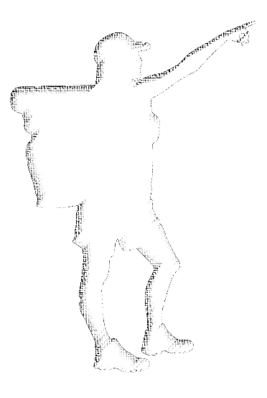
How can we share the Gospel?
Reflect and share – our own gospel resonance
Brainstorm – our gospel community together
a Gospel Plan…
Notes:
To frame our thinking on sharing the gospel, we’ll break this session up into a few stages –
First, we’ll think and share about which aspects of the gospel resonate with us, personally and particularly, and which aspects we feel most comfortable about potentially sharing with others, who may not know Jesus yet.
Then, we’ll have a group discussion about ways that, between us, as a whole gospel community, we could take the gospel to those around us – in this context where we are as a church together.
Then, we’ll process all of that and see if we can come up with a gospel plan – what we will do, to share the gospel with those around us. And ideally, we might see if we can land on a few action points that we agree that our church should follow up on.

Slide 16
How can we share the Gospel?
Reflect and Share…
Activity – ‘My gospel resonance’
Discuss –
  Anything you want to share about your own ‘gospel discovery’?
  Do we cover all the basics across our whole group?
Notes:
1. Reflect and share – our own gospel resonance
First, let’s think about our own personal points of resonance with the various elements of the gospel that we mapped out in session 1.
We are all wired differently, and have all come to Christ with different and quite personalised paths – our ‘gospel discovery’ stories won’t be identical. We might recognise that the way God brought his gospel to bear on us personally might naturally influence the way we would intuitively share the gospel with others – that there would be certain aspects that resonate particularly strongly with us, and that we might therefore be more comfortable or more instinctive in sharing with others.
With that in mind, I’d like us all to spend 5-10 minutes quietly reflecting on our own gospel discovery stories, and how that might have wired us for sharing the gospel with others. So, take a few minutes, and in your own time walk back around the room and re-visit the pages we put up before, and this time note that there’s a new scale on the bottom of the page: This scale is called, ‘resonance’, and it’s so that we can all mark down, ‘How much this aspect resonates with me.’ Essentially, what we’d like to end up with is everyone having put a mark on the scale – from LHS = not much, to RHS = very much – as to how much each of those aspects resonate with them, personally. Don’t worry about what everyone else marks up there, we’re all going to be different. Just think about your own level of passion and resonance – and your own level of comfort if you were to try to speak that aspect to someone else. Are you gospel-wired in this aspect of the message?
And so I think for this activity, we should set the scene with a much different scenario to the one before. And this time, a much more common scenario – that actually, most people need to hear the gospel several times, from various people, before anything clicks. But all of what they have heard, become part of their ‘gospel discovery’ – so nothing need be thought of as wasted. Rather, we should see ourselves as having an opportunity to just be part of the other person’s ‘gospel discovery’… what will we contribute towards that?
So with that in mind… Spend 5-10 minutes revisiting the various pages, and score your own personal gospel resonance with each of our points.
[Allow 15 minutes for the activity, including this intro.]
Let’s have a think about these things… [Invite people into 2 parts of the discussion on the slide, taking care with the first one that people are not disrespectful or dismissive of others’ wiring, and letting the second one explore possible implications like prayer/training if we have deficiencies across the whole group in sharing the various aspects of the gospel]
[Allow 15-20 minutes each for the 2 parts of the discussion phase.]

Slide 17
How can we share the Gospel?
Brainstorm…
What can our church do?
(collective personal capacity, working together to share the gospel, in our context)
Notes:
2. Brainstorm
With all that in mind, let’s now think about how we can share the gospel – that is, in our context as a church right here, how can we tangibly share the gospel with the world right around us here?
[Let this be a free-flowing brainstorm and discussion of ideas for 30-40 minutes. Facilitator to act as scribe, and use that role to keep people from getting bogged down or stuck on points by noting that the idea has been heard, welcomed, and written down as ‘X’, such that people can clarify wording, and then feel heard enough to move on to other ideas. Using butcher’s paper on a 6ft table might help people visually see that they have been heard… perhaps divide it into LHS and RHS and use the LHS for this brainstorm of ideas…]

Slide 18
How can we share the Gospel?
a Gospel Plan…
What will we do?
Scribe: Summarise and write down clear statements.
Everyone: Discuss and decide…
(basic, concrete things, that we want to take on as a church, and follow through on together)
Notes:
3. a Gospel Plan
So… the big question left now, is ‘What will we do?’
Can we put together a ‘gospel plan’ for our church, with some basic but concrete things we want to do together as a church, and that we are want to follow through on after today?
[Let this be a free-flowing brainstorm and discussion of ideas for 30-40 minutes. Appoint a scribe to summarise (or oversee someone summarising) whatever clear and cohesive statements, to create an itemised ‘Gospel Plan’ for the church. Use pen and paper and if need be revise/edit and work towards a final version of the plan neatly written on a fresh page. Or, perhaps use the RHS of the piece from the brainstorm activity on the previous slide, dividing that RHS into 2 new sections: 1) a shortlist of the things the group wants to follow up on, and 2) some clear, concrete statements of those shortlist points.]

Slide 19
Closing Reflection
We always thank God, the Father of our Lord Jesus Christ, when we pray for you,
since we heard of your faith in Christ Jesus and of the love that you have for all the saints,
because of the hope laid up for you in heaven.
Of this you have heard before in the word of the truth, the gospel, which has come to you,
as indeed in the whole world it is bearing fruit and increasing—as it also does among you,
since the day you heard it and understood the grace of God in truth…
Colossians 1:3-6
Notes:
Thank you for sharing in this important topic today. As we finish up, let’s not finish up and set this topic aside now, but let’s take it on in the life of our church and see just what Jesus will do through our efforts to take the gospel to our part of the world. And let me encourage us all with this Scripture, from Colossians 1, where Paul and his gospel co-workers write –
We always thank God, the Father of our Lord Jesus Christ, when we pray for you,
since we heard of your faith in Christ Jesus and of the love that you have for all the saints, because of the hope laid up for you in heaven.
Of this you have heard before in the word of the truth, the gospel, which has come to you, as indeed in the whole world it is bearing fruit and increasing—as it also does among you,
since the day you heard it and understood the grace of God in truth…
Colossians 1:3-6
The gospel is increasing, as Jesus continues to bring people into his church, by the power of his gospel to save (Romans 1:16). So too it is bearing fruit, as people are set free from the power of sin, to live new lives being transformed more and more like Jesus Christ, to his glory. We need not doubt what God will do through his gospel. And nor what He will do through you and I, as we simply find the courage and conviction to speak the good news about Jesus in this world.
How beautiful are our feet, as we step into this call!

Slide 20
Prayer
Notes:
Prayer
Spend 10 minutes in open prayer, committing the whole equip teaching day to God.
Facilitator to close prayer, asking that the Spirit of Christ would be active within and among us, such that we forge ahead together as a church worthy of his name. Specifically, ask that God would move us to be focused and bold with our proclamation of God and His promises, to reach out in love to our community and other circles, and to love one another and keep each other accountable and in step with the Spirit, as brothers and sisters of Christ.

